Slide 1
A new Machine Learning based approach to analyse player performance in T20 Internationals

Slide 2
Introduction
Sports analytics has benefited greatly from the development and acceptance of machine learning methods. Traditional metrics can help with these comparisons, but analytics provides the crucial context.
In the shortest format of the game, each player in the team has a defined strategic role like opening batters will have to score runs at a steady rate without losing wickets and person who comes at the end of the innings has a responsibility to score runs quickly by hitting as many boundaries as possible. Both the players have different role and but traditionally judge by the same metrics such as average and strike rate.
The traditional metrics used to compare batters and bowlers are listed below:
Strike rate for batters : 100 * (Total Runs / Total Balls faced)
Average for batters: Total Runs / Total times batsman got out
Strike rate for bowlers : Balls bowled / Total Wickets
Average for bowlers : Total Runs / Total Wickets
Economy for bowlers : Total Runs / Total Overs bowled
Notes:
Sports analytics have been benefited greatly from the machine learning algorithm. In this research we have tried to incorporate Machine learning techniques with the Shortest Format of the cricket game. Each player has a role defined like opening batter needs to score run at steady rate while batter who come at the end of the innings needs to score runs quickly by hitting as many boundaries as possible. Issues with average ‘Lance Klusener scored 281 runs in eight innings and was only struck out twice during the 1999 World Cup Series. His best score was 52, but he had a 140.5 average! ’

Slide 3
About Dataset
This study considered data from the start of T20 International to April 17th, 2022. Both active and retired players are present in this collection. We had 4000 entries in the dataset, with 2000 entries for each batter and bowler.
For batters during their T20 career, Innings, Not Out, Runs, Average, Strike rate, Number of Boundaries, Times a Player Was Out Without Scoring Runs, and Balls Faced are included.
For bowlers also includes the number of overs bowled, the number of debut overs bowled Best Bowling, statistics, and wickets taken, average, and strike rate of a bowler, as well as how many times they have taken three or more wickets.
Both batter’s and bowler's data are skewed towards the left side in all aspects because many players have played few games. To account for this, reduce bias, and ensure that our model functions properly, this study excluded any batters who have played fewer than 25 balls or fewer than four innings of batting, as well as any bowlers who have bowled in less than four innings.
After removing outliers, we were left with 1400 records for batters and 1167 for bowlers.
Notes:
Web scrapping finding tags, pagination, giving last date. ,Removed ambiguous entries from countries. Replacing batters average by highest score for 54 batters, who were yet to be dismissed in T20 Internationals. Before applying Models and getting roles based on clustering, we have used a preliminary based on average, strike rate and economy rating and categorize player (Best, Good, Average and Poor). Switch to shuffling the dataset in Dissertation.

Slide 4
Key Performance Index
In this study, We have extracted five KPIs for each batsmen and bowlers, rather than setting them specifically for each role, we have established these KPIs without taking the player role into account.
1 | Boundary Per Ball | Total boundaries (4’s + 6’s) / Total balls faced
2 | Boundary Index | Total boundaries (4’s + 6’s) / Total innings
3 | Finishing Index | Number of times batter remained not out / Total innings
4 | Runs Without Boundary Index | Number of runs scored without boundaries / Total innings
5 | Big Match Index | (2 * Centuries + half centuries) / Total innings
Table 1: Extracted KPI for Batters
1 | Balls Bowled per Innings | Number of balls bowled / Total innings
2 | Wickets Index | Number of wickets taken / Total innings
3 | Big Impact Index | Number of times bowler picked more the 3 wickets / Total innings
4 | Short Impact Index | Wickets were taken without Big Impact Innings / Total innings
5 | Runs Index | Number of Runs Conceded by bowler / Total innings
Table 2: Extracted KPI for Bowlers

Slide 5
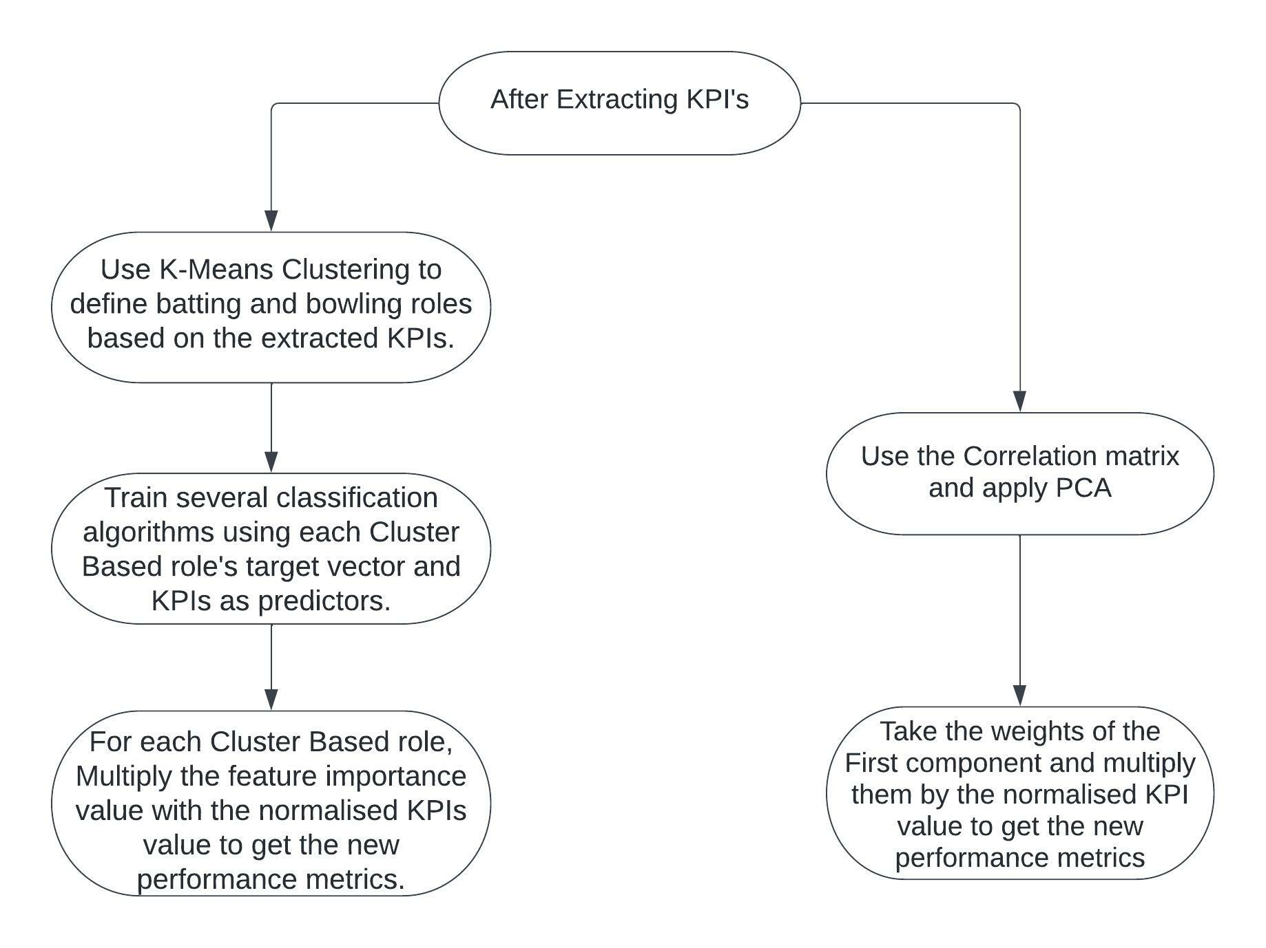
Methodology
Notes:
2nd methodology can be considered as extension of An Introductory Application of Principal Components to Cricket Data by Manager and Scariano in 2013 but at the end PCA provided a meaningful when combined with K-means.

Slide 6
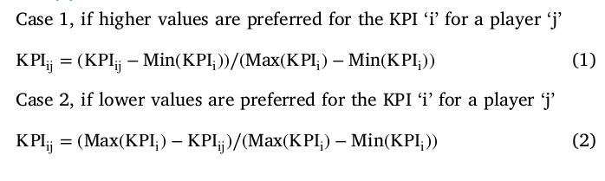
Methodology(cont.)
Feature scaling
K-means Clustering to divide players according to their roles and that roles can be further used as target vector in classification process.
One vs all classification to get the role-based feature importance.
Notes:
In this study, most of the extracted KPIs have smaller values, but the traditional metrics such as strike rate, economy, and average have much higher values as compared to KPIs we have defined. But for Bowlers some KPIs Average, Strike rate, economy and runs index prefer lower values. The lower the values the good the bowler is. K-means clustering (switch to dissertation/code to show cluster center(s)). Then we have performed classification based on results from K-means clustering and to get role based-based feature importance for each class we have used one vs all classification. For e.g., if we need feature importance for SB in batters' players who have categorized as SB were kept as 1 rest other were kept as 0 to get the feature importance for group of players.

Slide 7
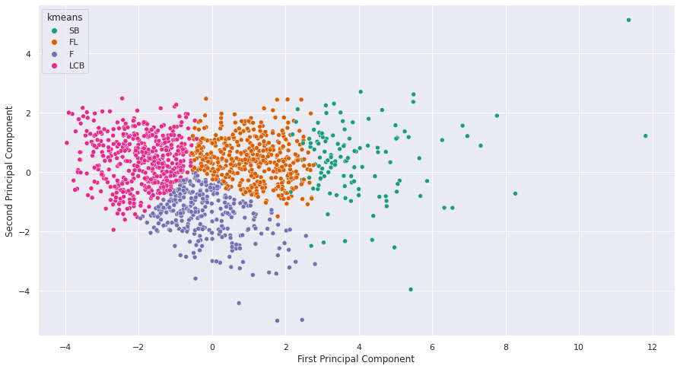
Results for Batters
Notes:
PCA graph with points separated as clustered by K-means.(Switch to PCA values)

Slide 8
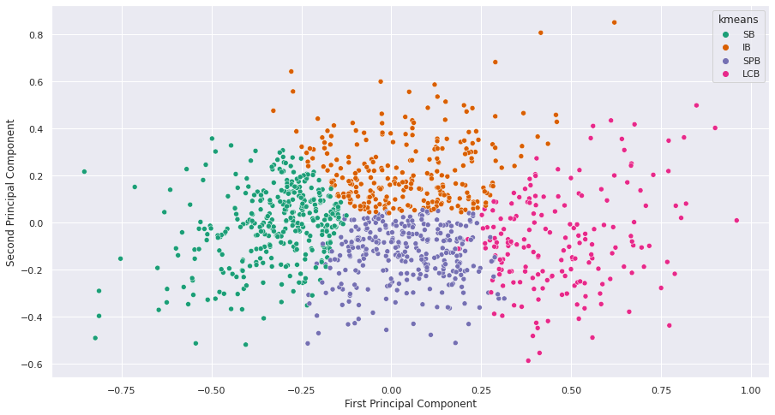
Results for Bowlers
Notes:
PCA graph with points separated as clustered by K-means.(Switch to PCA values)

Slide 9
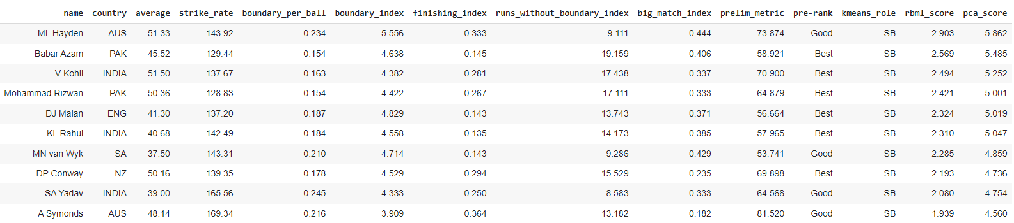
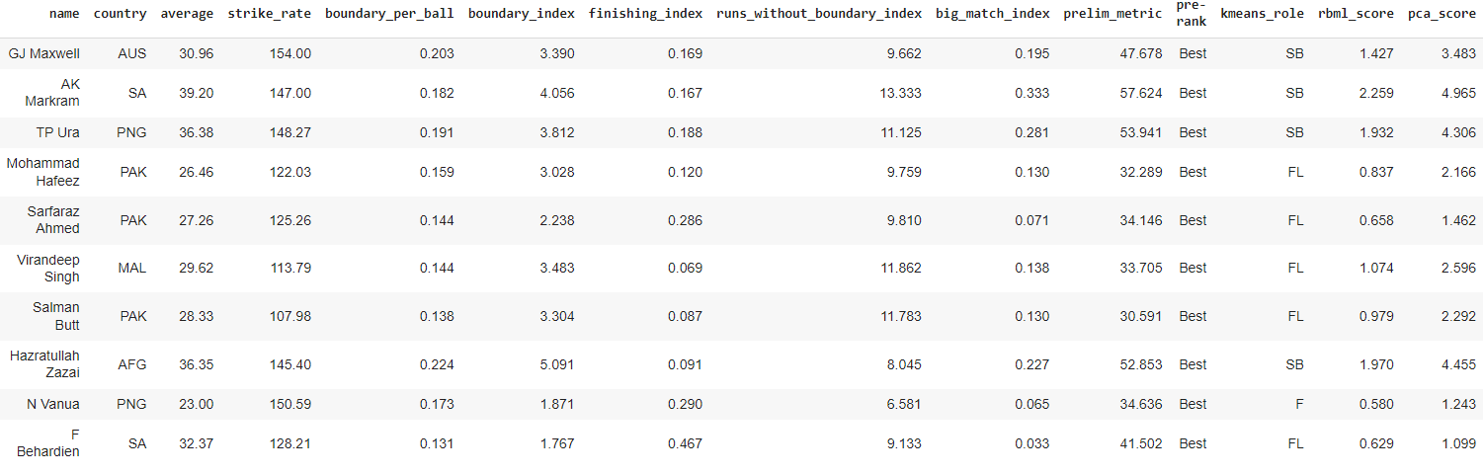
Evaluation
Notes:
SB batters and Test batters who were Best. New players like surya kumar Yadav has also been included. All the TOP 3 players right now according to ICC players ranking are in the TOP 10 players by RBML score. (To be considered this data is before 18th April 2022) After that surya has played astonishing knocks to. If data considered until now, he might be in TOP 5 rank.

Slide 10
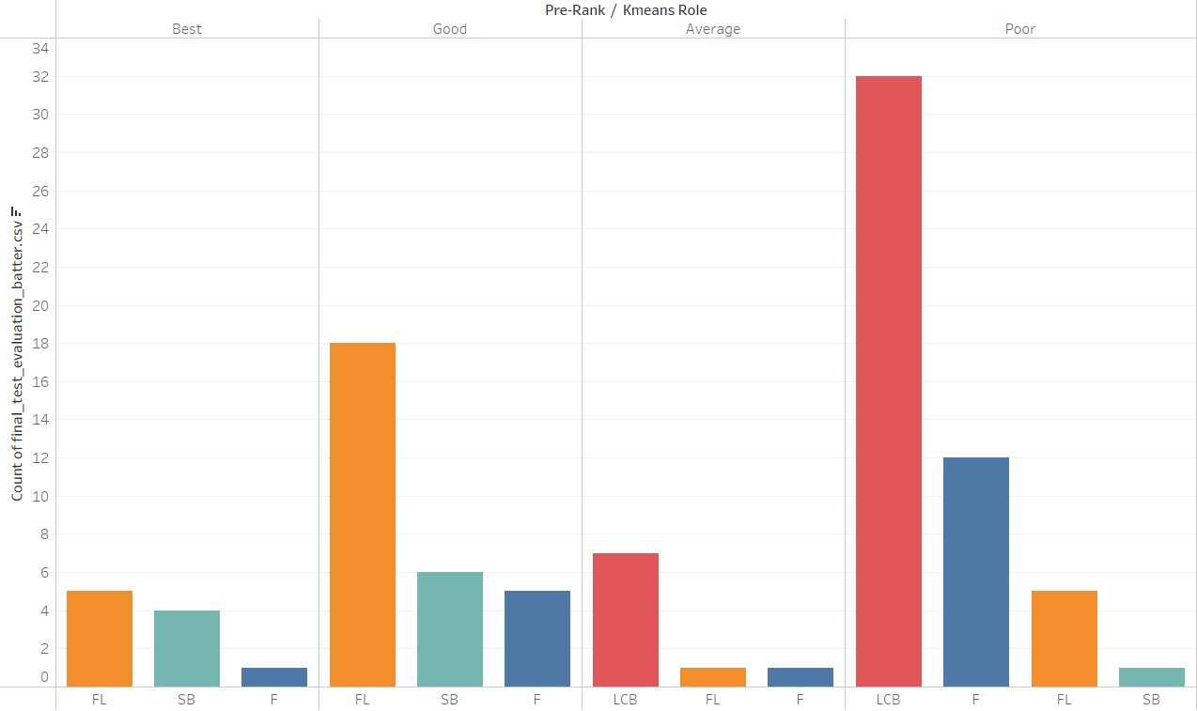
Evaluation(Cont.)
Notes:
Batter classification which were kept for test. Out of 50 batters who were classified as poor by prelim 32 were turned out to be LCB,12 Finishers,5 as floaters and 1 as SB. None of batter from PR rank Good/Best has been classified as LCB. Out of 10 Best ranked batters 5 were classified as FL, 4 as SB and 1 as F.

Slide 11
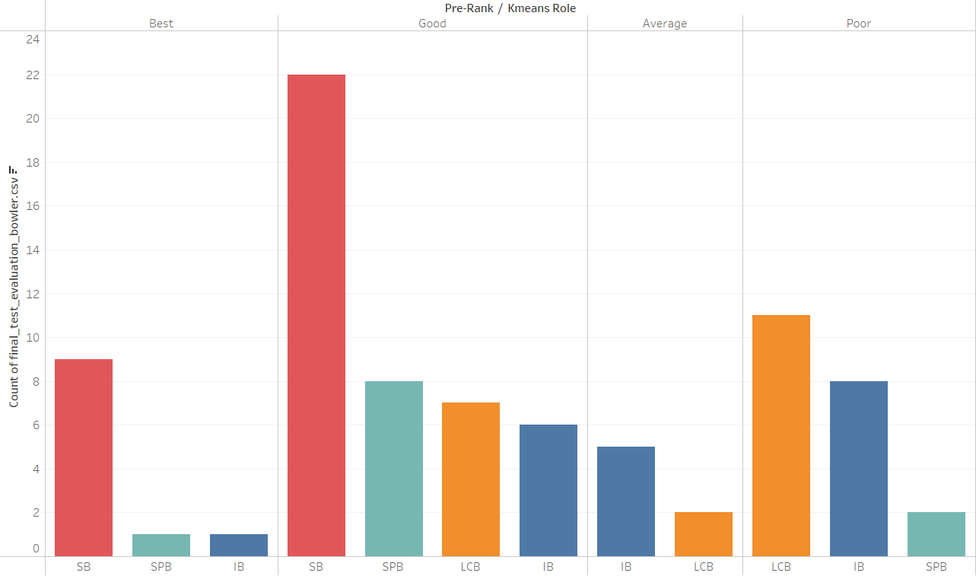
Evaluation(Cont.)
Notes:
Bowler classification which were kept for test. 43 bowlers who were classified as Good by prelim rank 22 were classified as SB, 8 were classified as SPB, 7 as LCB and 6 as IB. Out of 11 classified as Best 9 are classified as SB and 1 each in SPB and IB. This demonstrates that rather than classifying players based on their Prelim rank, which is based on traditional metrics, it is preferable to classify players based on their roles..

Slide 12
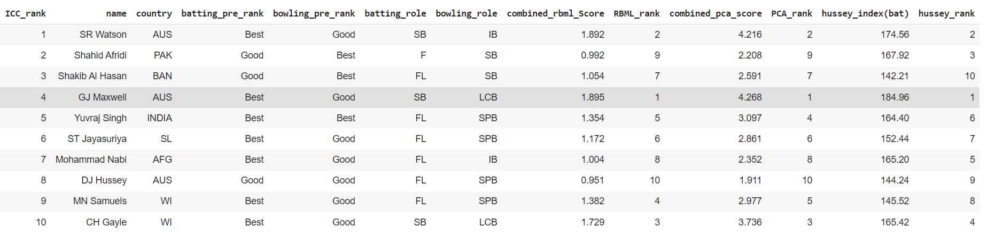
Evaluation(Cont.)
Notes:
ICC all time TOP 10 all rounders. We can see in that figure the batting and bowling roles that our player was assigned based on our research. Numerous batting and bowling combinations can be used to categorise an all-around player. Rather than saying Bowling all rounder or Batting all rounder, we can say that the player is specialist batter and Impact Bowler. In this figure we can say that a player who is Specialist Batter has dominated RBML and PCA scores.

Slide 13
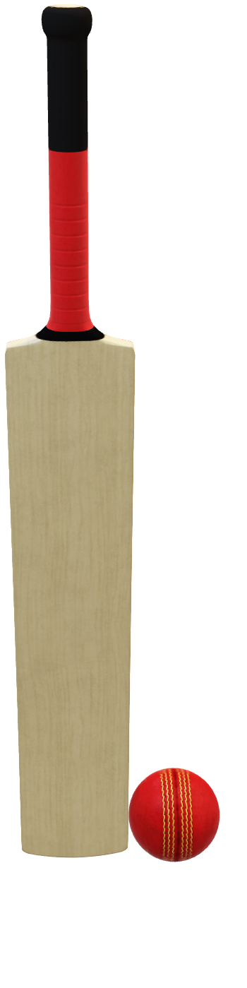
Thank You

